Slide 1
Page 1

Slide 2
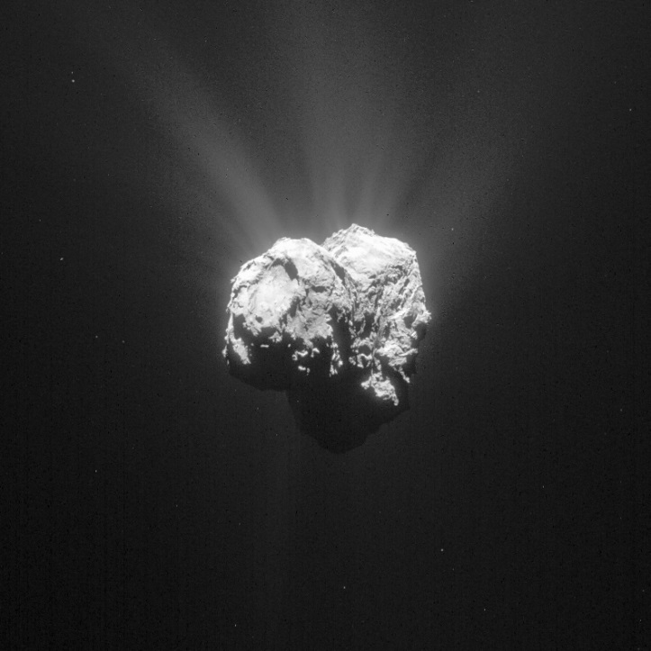
Page 2

